Slide 1
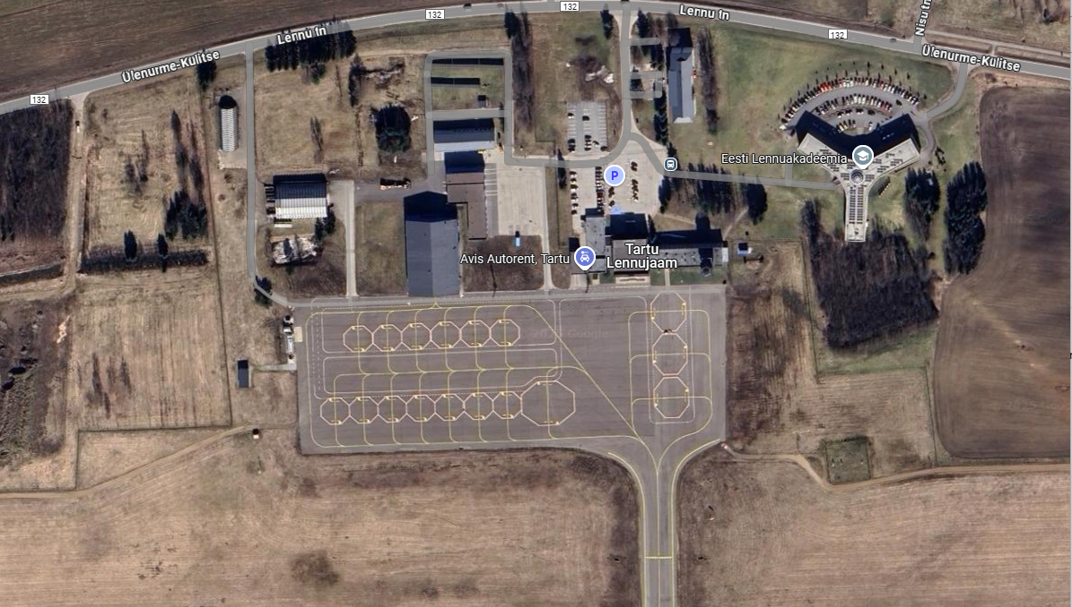
Attachment 1 Operation area
Max altitude 120 m (390 feet) AGL
Operational area
Ground risk Buffer
Adjacent Area

